Slide 1
Welcome to all
for the PSK Online lecture
Chapter 3
Scientific Purchasing
By
Dr. Dhiraj Ovhal
HOD of Commerce

Slide 2
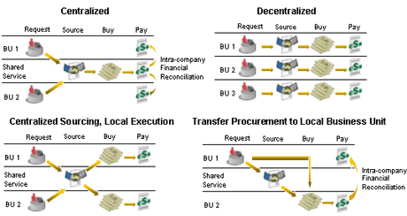
Q.4 Explain the various functions of Purchase department ?

Slide 3
Q.4 Explain the various functions of Purchase department ?
Meaning:-
The Purchase Department is responsible for all purchasing and contracts with outside suppliers.
No contracts or negotiations should be made with existing or prospective vendors by any other department except with cognizance of the purchasing department.

Slide 4
Q.4 Explain the various functions of Purchase department ?
The main functions of purchase department are as follows:
Placement of Order
Purchase Records
Purchase Reports
Forecasting and Future planning
Vendor selection and Marinating relation
Checking Invoice and Fixing Price
Inspection

Slide 5
1.Placement of Order :-
Analyzing various quotations received from different vendors Scheduling purchases and delivery Issuing proper purchase orders Negotiating prices with vendors Arriving at right price
Approving invoices.

Slide 6
2. Purchase Records:-
Registration with vendors with their personal information of suppliers to be maintained Records of all the materials purchased Record of imported items
Other legal information related to purchases.

Slide 7
3 Purchase Reports :-
Record of budgets before the year starts Vendor performance report
Pattern of market prices Value of major items purchased Purchase done department-wise Total cost of purchase

Slide 8
4. Forecasting and Future planning :-
Anticipating advance needs of the user department
To avoid interdepartmental clashes
To reduce rush orders

Slide 9
5. Vendor selection and Marinating relation:-
Selecting vendor for required items Searching alternative suppliers
Investigating interested parties •
Visiting plants by seniors
Interviewing salesmen Keeping trust and confidence on vendors
To ensure vendor quality services,

Slide 10
6. Checking Invoice and Fixing Price:-
Fix the prices and check invoices
Follow accounting procedure for checking invoices
Clerical procedures to carry to check the invoices,

Slide 11
7. Inspection :-
Inspect the physical purchases through production department Finding out defect in the materials before use Rejecting shipment if found inferior materials.

Slide 12
Thank You

Slide 13
Q.4 Explain the various functions of Purchase department ?
Placement of Order
Purchase Records
Purchase Reports
Forecasting and Future planning
Vendor selection and Marinating relation
Checking Invoice and Fixing Price
Inspection

Slide 14
Attendance Link
https://forms.gle/Xqvykv5vfEi1zpyF7
(Mention date at last point)

